Slide 1
Final Design Presentation
Xiao Yang, Zhi Dong.

Slide 2
Overview of Design
Client
Server
votes
Voters
Subclasses of voters

Slide 3
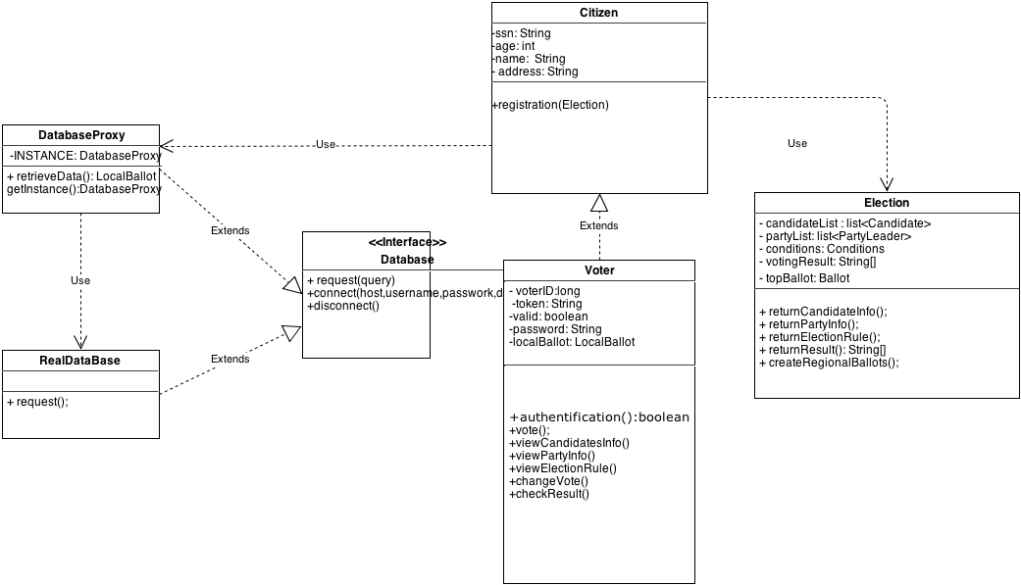
Registration（Proxy, Singleton）

Slide 4
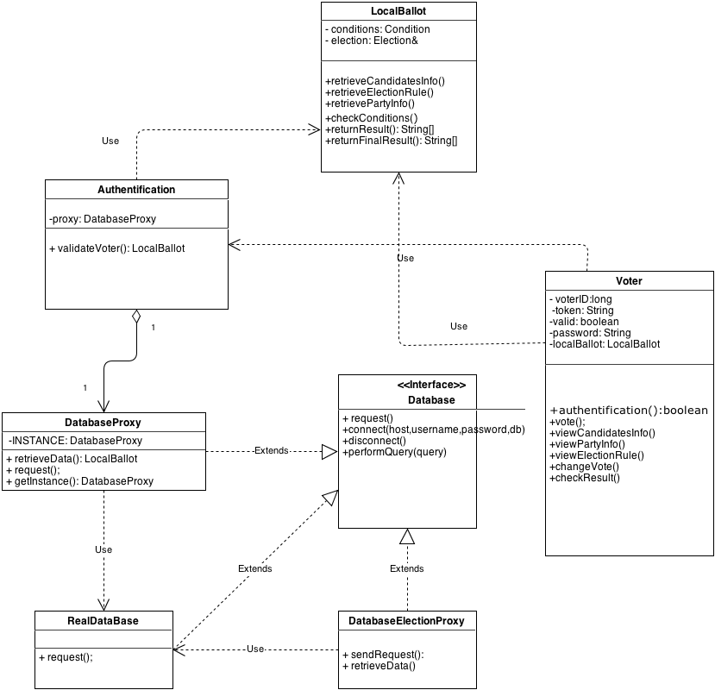
Authentication（Proxy）

Slide 5
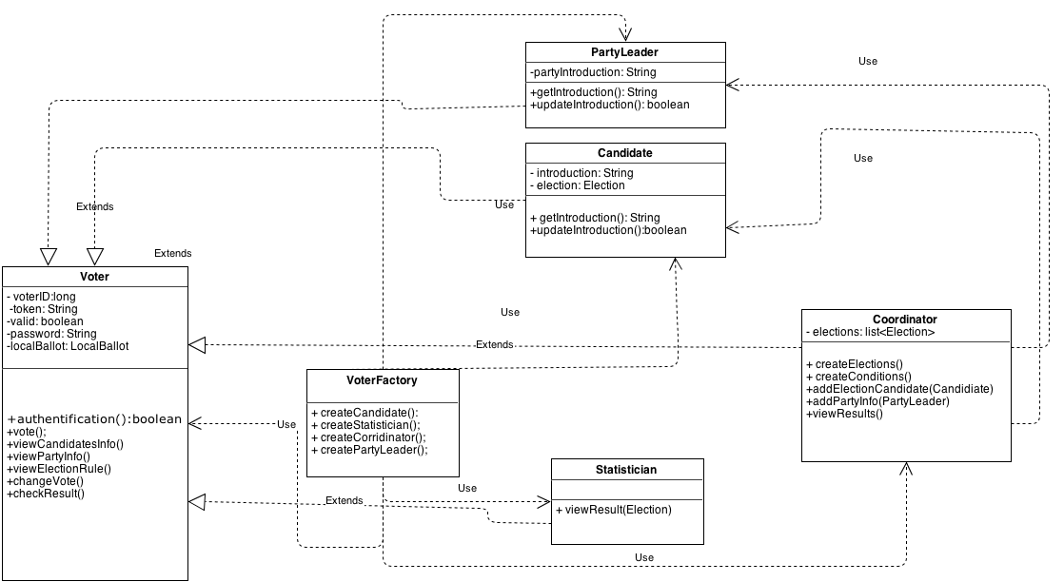
Voter Factory

Slide 6
Ballot Factory（Factory, Composite, Chain of Responsibility）

Slide 7
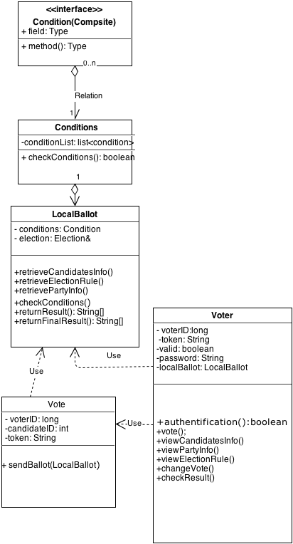
Voting

Slide 8
Anonymized Voting
Using a token based method
After the local ballot received the name and voting time, then it generates a token which is stores in database <token, candidate>, where token is not able to be inferred.
As some revote happen, it looks up for the record in database based on the token. Subtract 1 from the previous candidates vote number, add 1 on the changed candidate’s vote number.

Slide 9
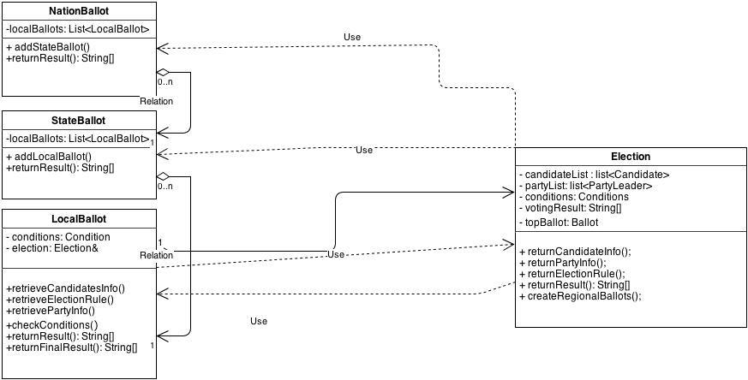
Return results

Slide 10
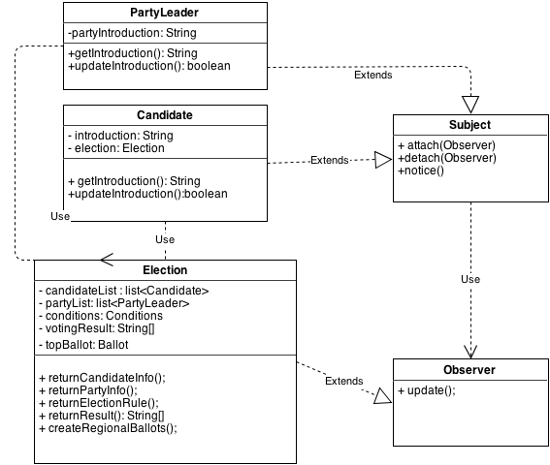
Information Updated(Observer)

Slide 11
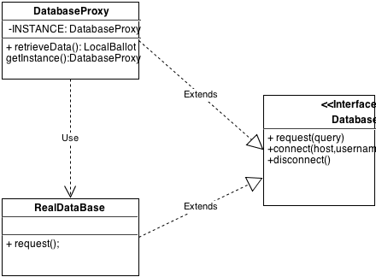
Database Singleton

Slide 12
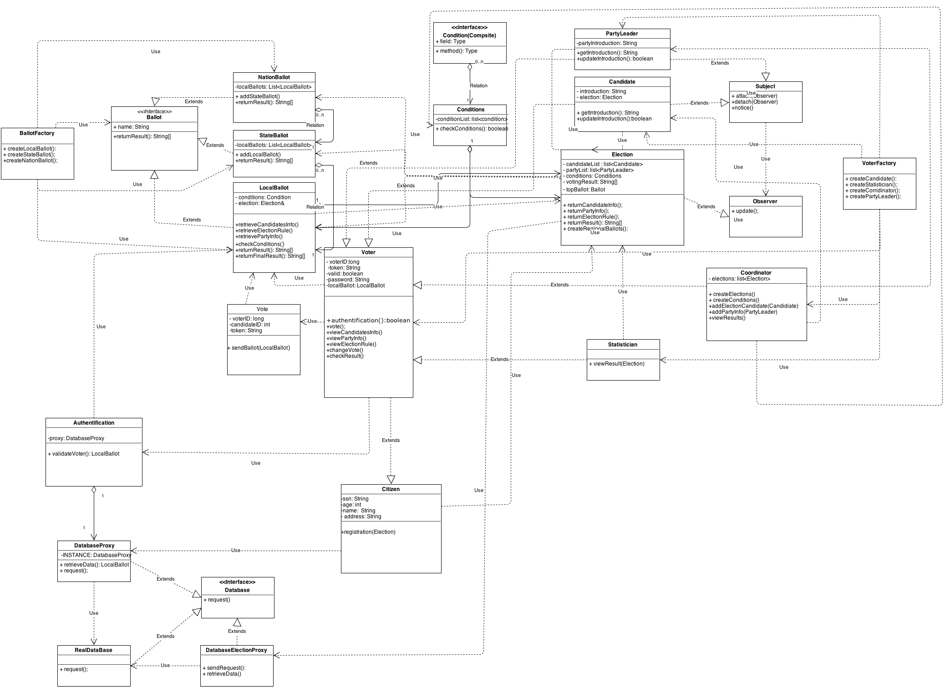
Overview of Design continued

Slide 13
Questions?

